Slide 1
Figures
January 2025

Slide 2
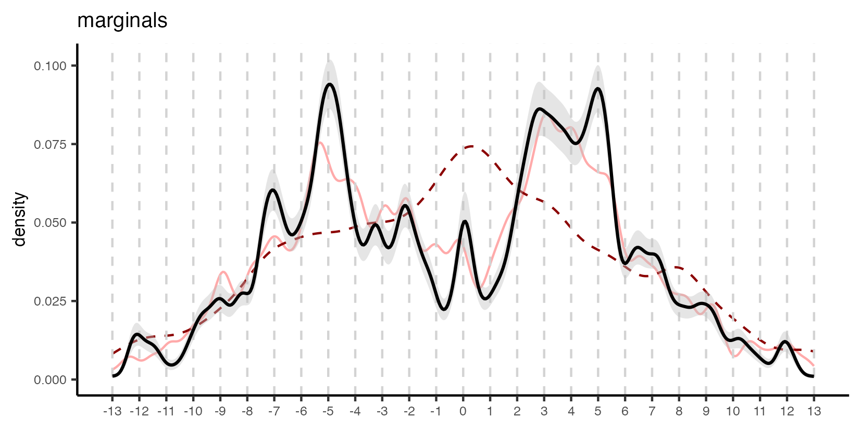
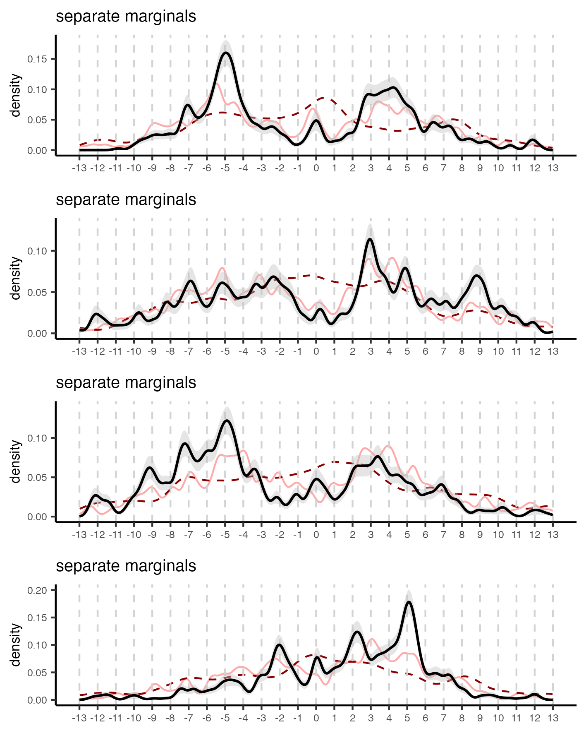
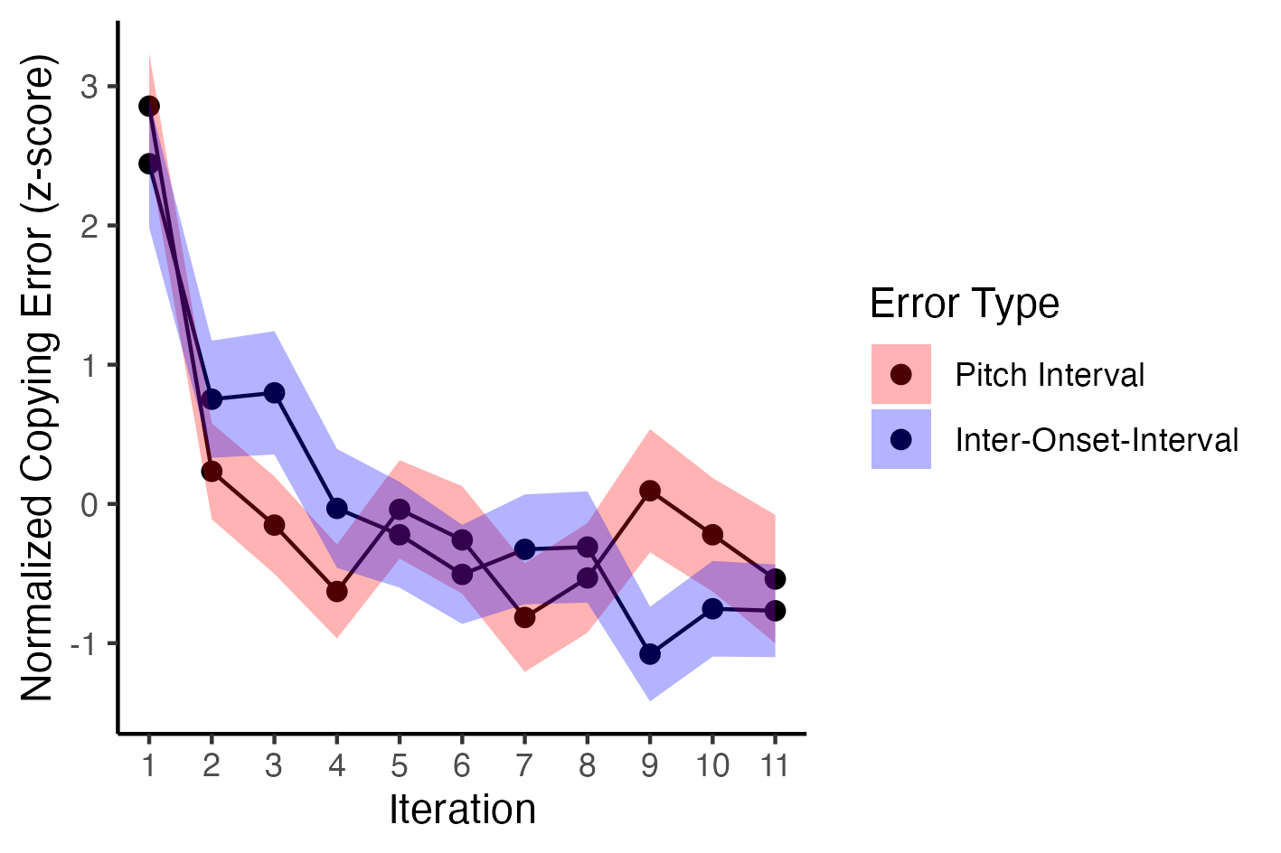
A
B
C
D
Distribution of pitch intervals
Interval 1
Interval 2
Interval 3
Interval (semitones)
Entropy
Learnability
Interval 4

Slide 3
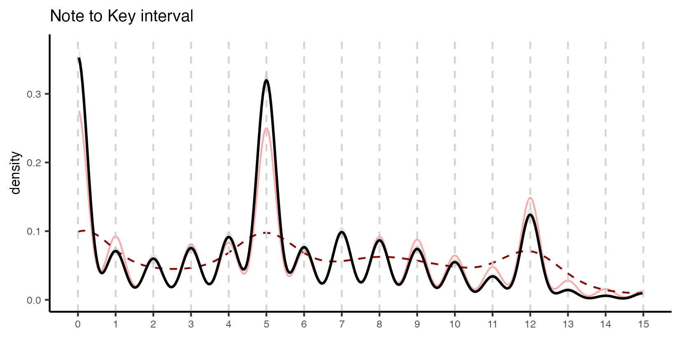
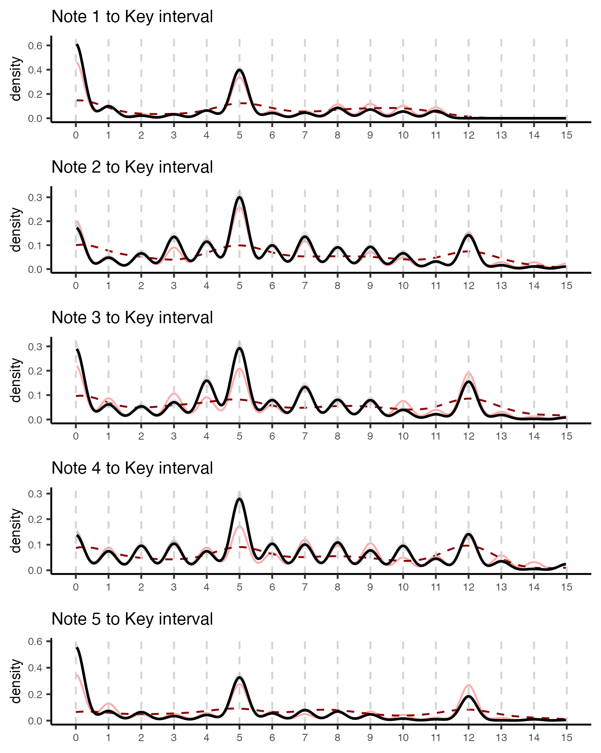
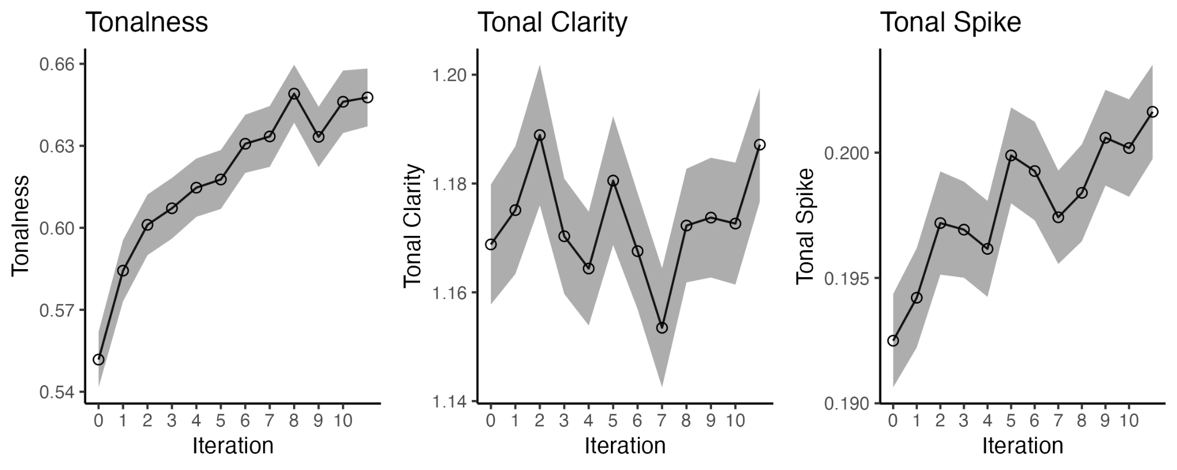
A
B
C
Distribution of intervals relative to key
Interval between notes and key (semitones)

Slide 4
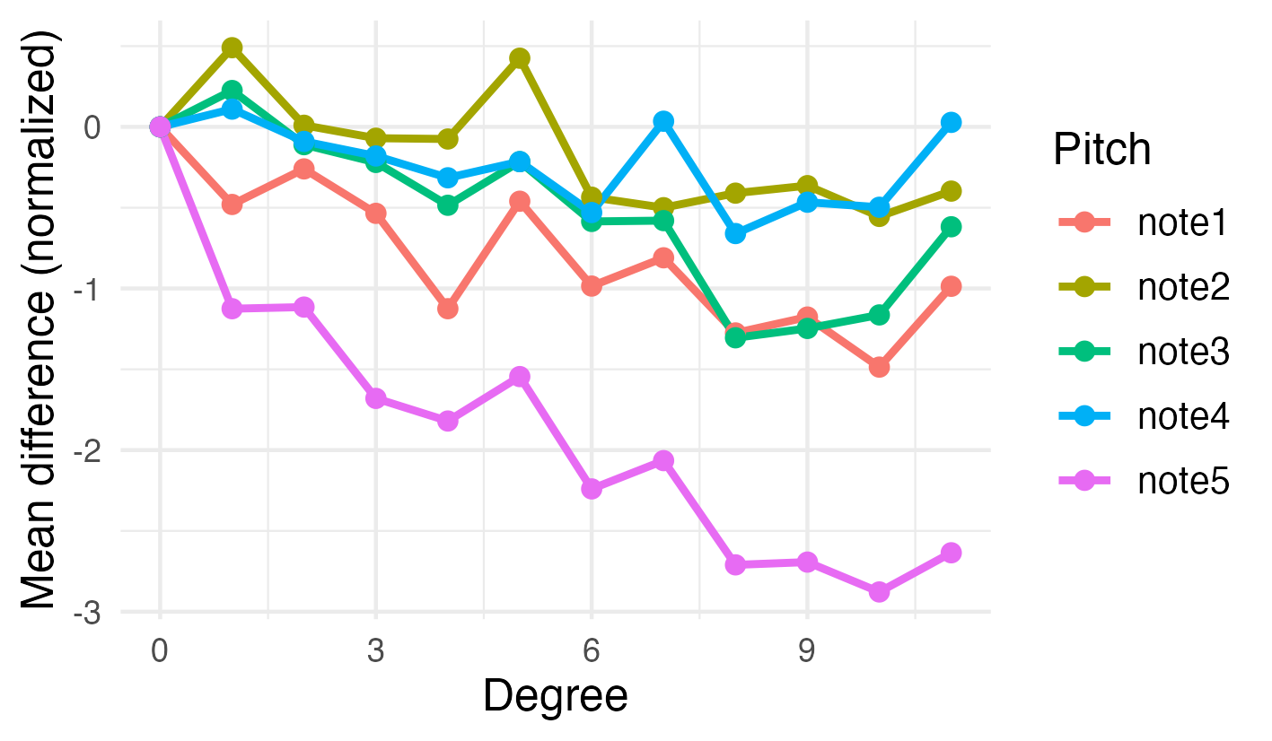
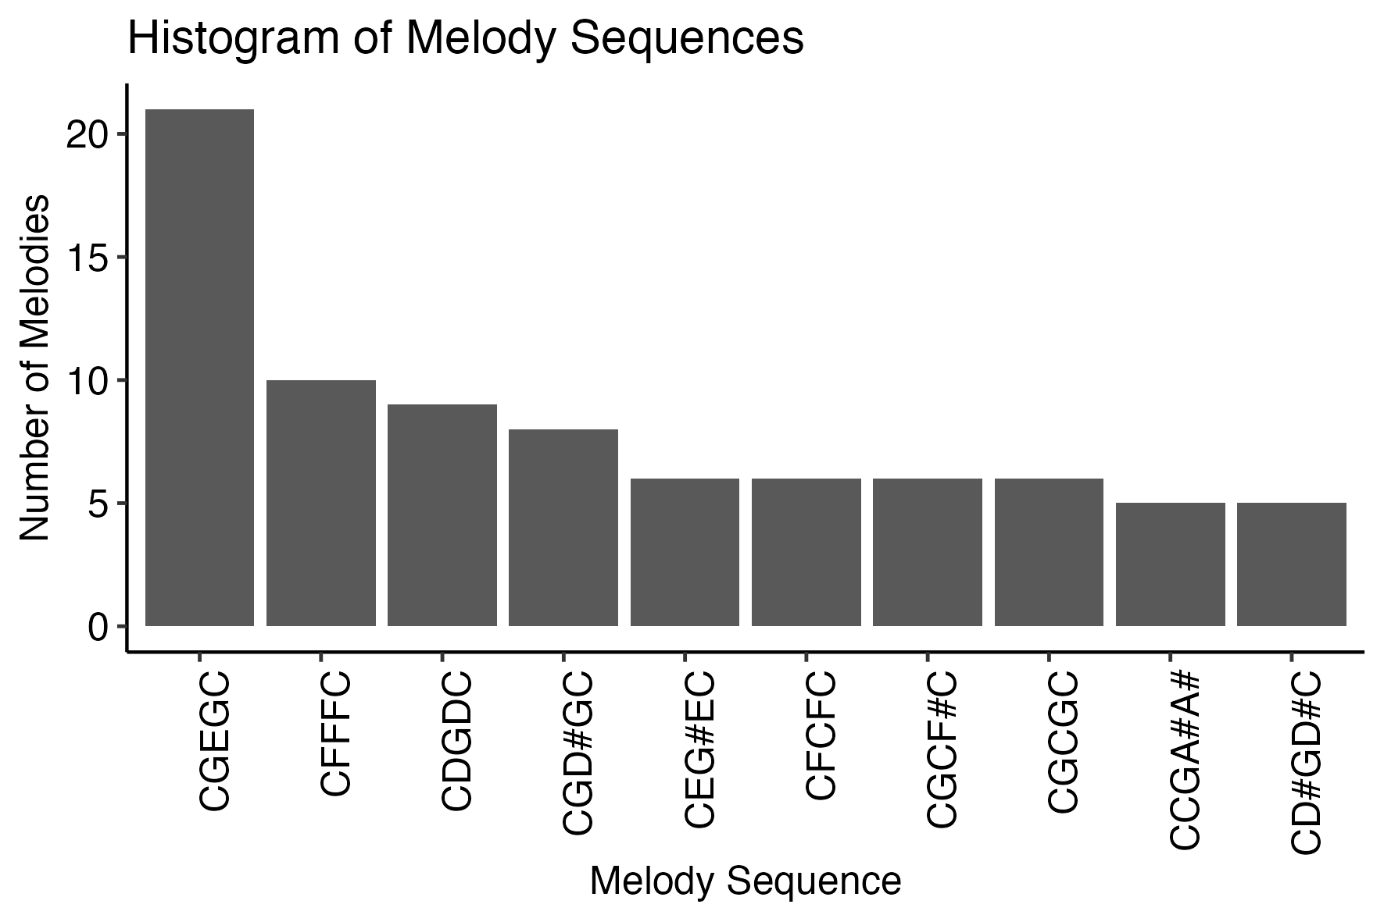
A
B
C
D
Distribution of intervals relative to key
Interval between notes and key (semitones)

Slide 5
Results 2
December 2024

Slide 6
Finding 1: emerge of musical structures
Interval 1
Distribution of pitch intervals in the last 3 generations
Interval 2
Interval 3
Evolution marginals: we could show the same marginals over iterations
Interval 4

Slide 7
Finding 1: emerge of musical structures
Melodies become easier to learn and transmit
Emergence of structure: add plot showing the how the entropy of intervals and IOIs decreases over time (structure emerges)

Slide 8
Finding 2: emerge of tonal structures
Distribution of intervals between melody notes and estimated key

Slide 9
Finding 2: emerge of tonal structures
Emergence of tonality and tonal features

Slide 10
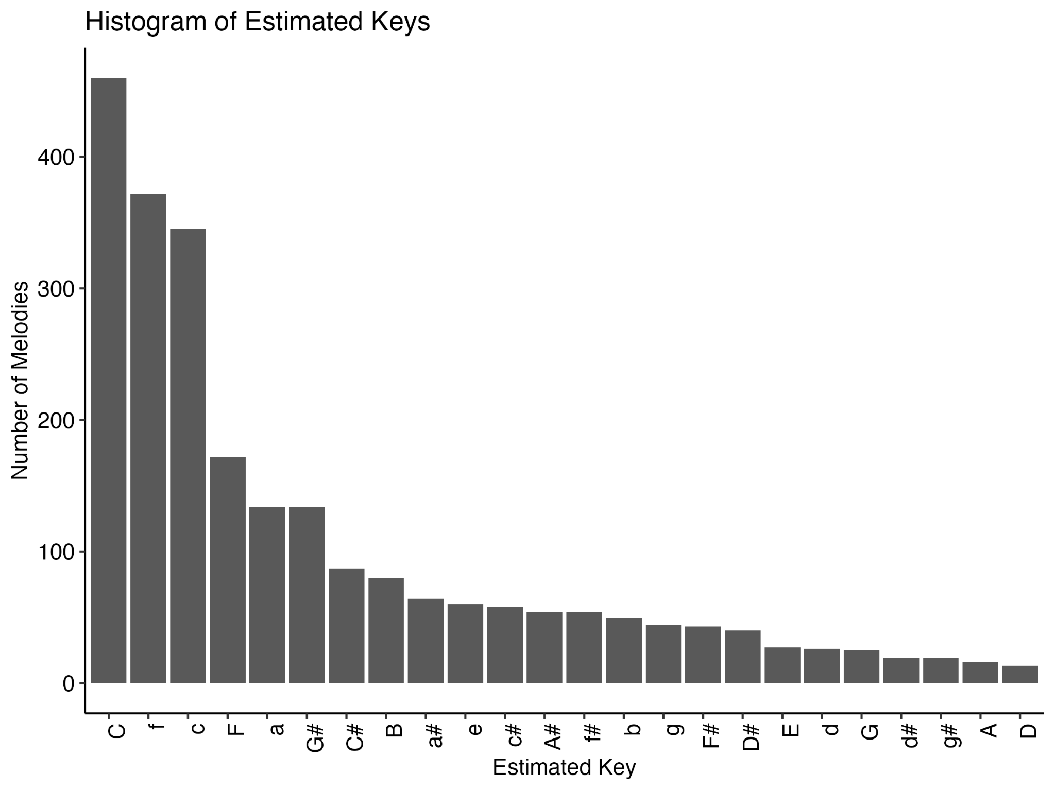
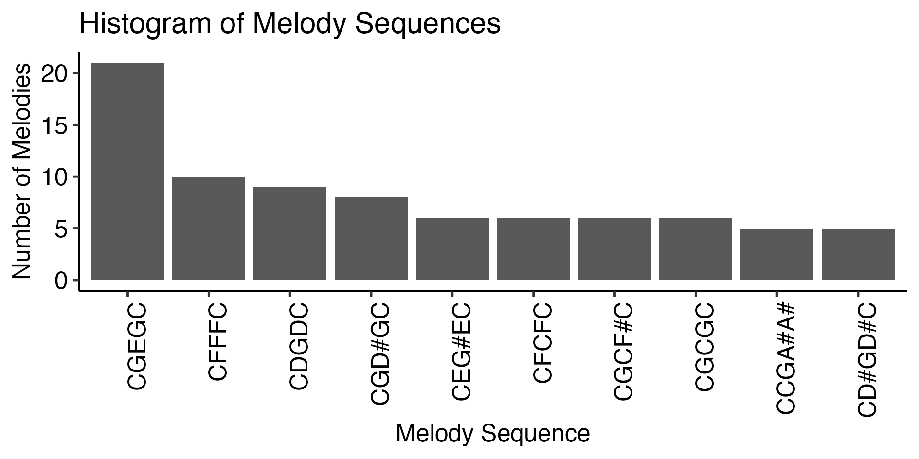
Finding 2: emerge of tonal structures
Optional

Slide 11
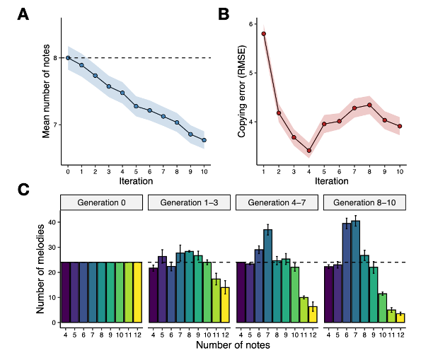
Finding 3: emerge of musical scales with a few notes
I could repeat this experiment using our current pipeline and then we could study tonal features of the melodies that emerge too (like most common scales)

Slide 12
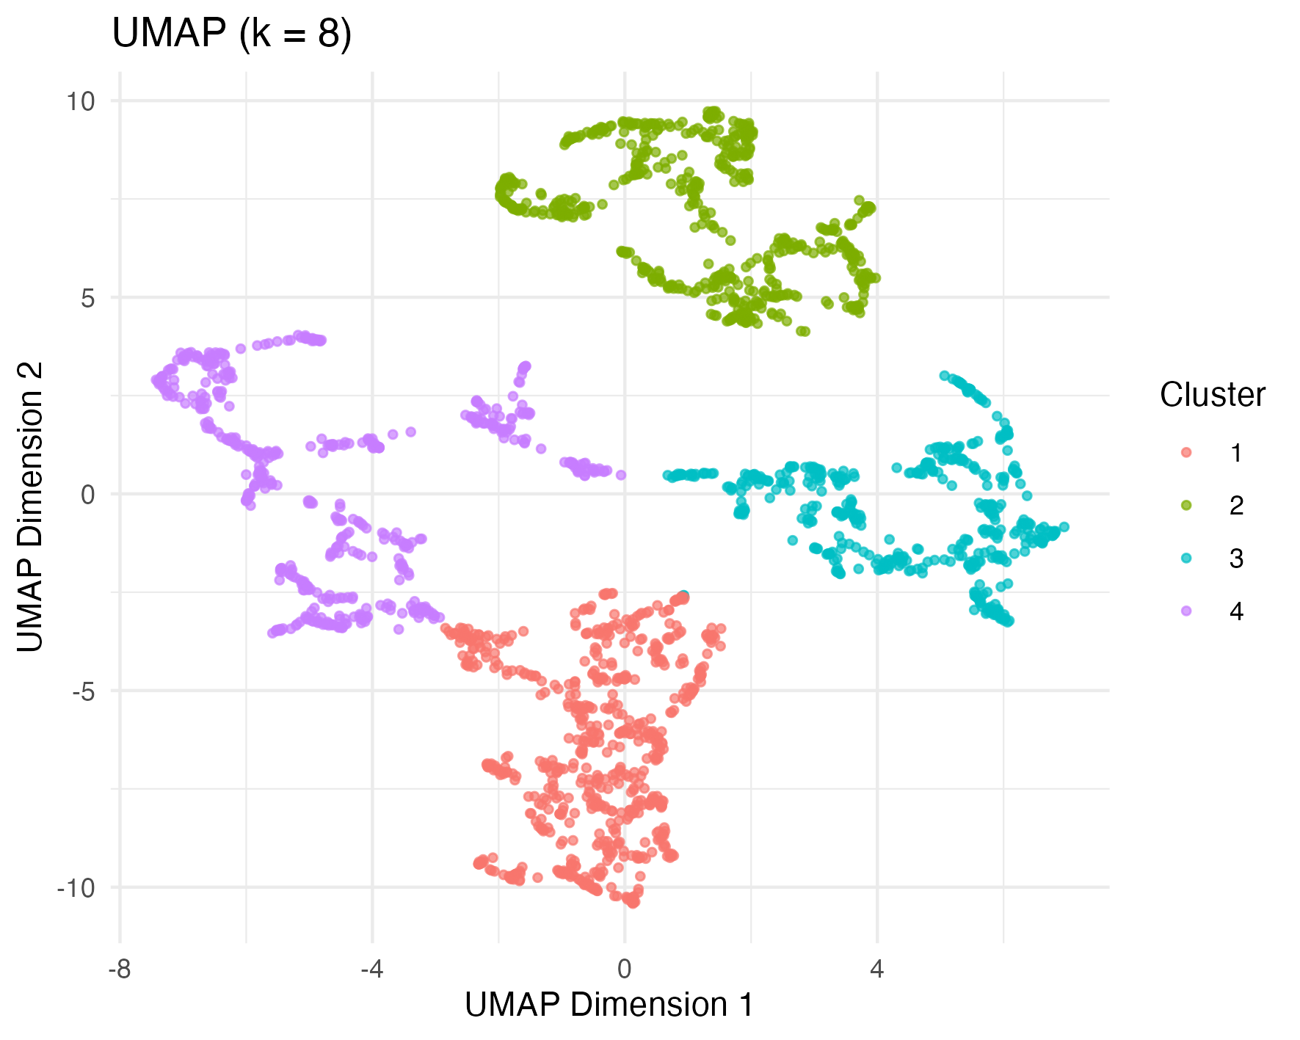
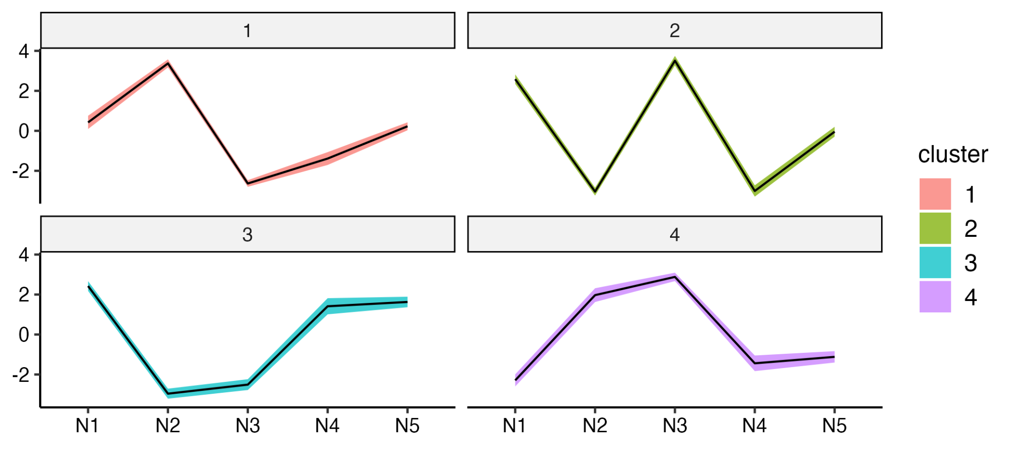
Finding 4: emerge of melodic contours
One option would be to introduce the emergence of these contours and study differences in tonal structures on these contour types

